Slide 1

Office of Scientific Quality Review
Dr. Scott Yates, Scientific Quality Review Officer
Dr. Michael Strauss, Peer Review Coordinator

Slide 2
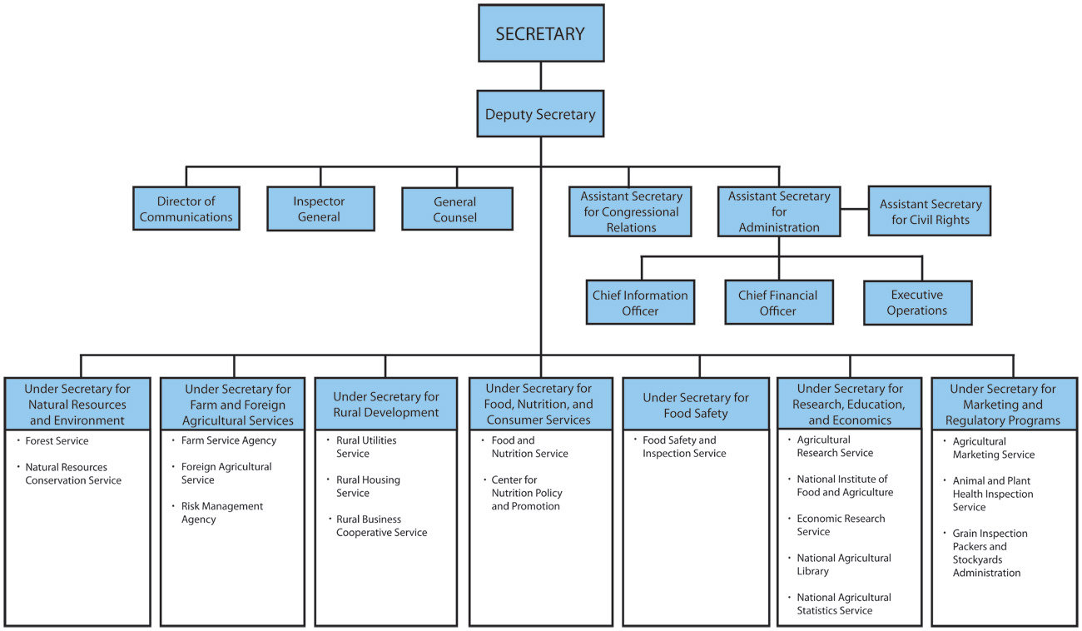

Notes:
This chart depicts the Headquarters organizational structure of the Department of Agriculture and the relationship of the REE Mission Area and the respective Agencies in the Mission Area to the other Mission Areas of the Department.
The Agricultural Research Service is part of what is now known as Research, Education, and Economics (REE)–Mission Area, with Dr. Joe Jen as the Under Secretary. Dr. Rodney Brown is Deputy Under Secretary.

Slide 3

Agricultural Research Service
In-house research
Farm-to-table scope
16 National Programs
1,000+ projects
2,000 scientists
100 labs
$1B annual budget
Notes:
This slide provides a few key facts about ARS. We are the in-house research arm of USDA. Our research program covers the broad scope from farm to table, or production to consumption.
For research planning, coordination, and communication purposes, ARS divides its research into 22 National Programs each of which encompasses a number of contributing projects.
Overall, the total ARS research program is carried out by about 1,100 projects, each having specific objectives and work plans, covering a three to five year time frame, and the work of an interdisciplinary team of two or more scientists.
We have a total of more than 8,000 employees, including about 2,100 PhD career scientists.
Our research is carried out at about 100 laboratory locations geographically distributed throughout the United States, and also at several foreign locations.
Our annual budget, consisting mostly of appropriated funds from the U.S. Congress is now nearly $1 billion.
And much of our research is carried out in partnership with university and industry organizations. Many of the ARS laboratories are co-located with universities.

Slide 4
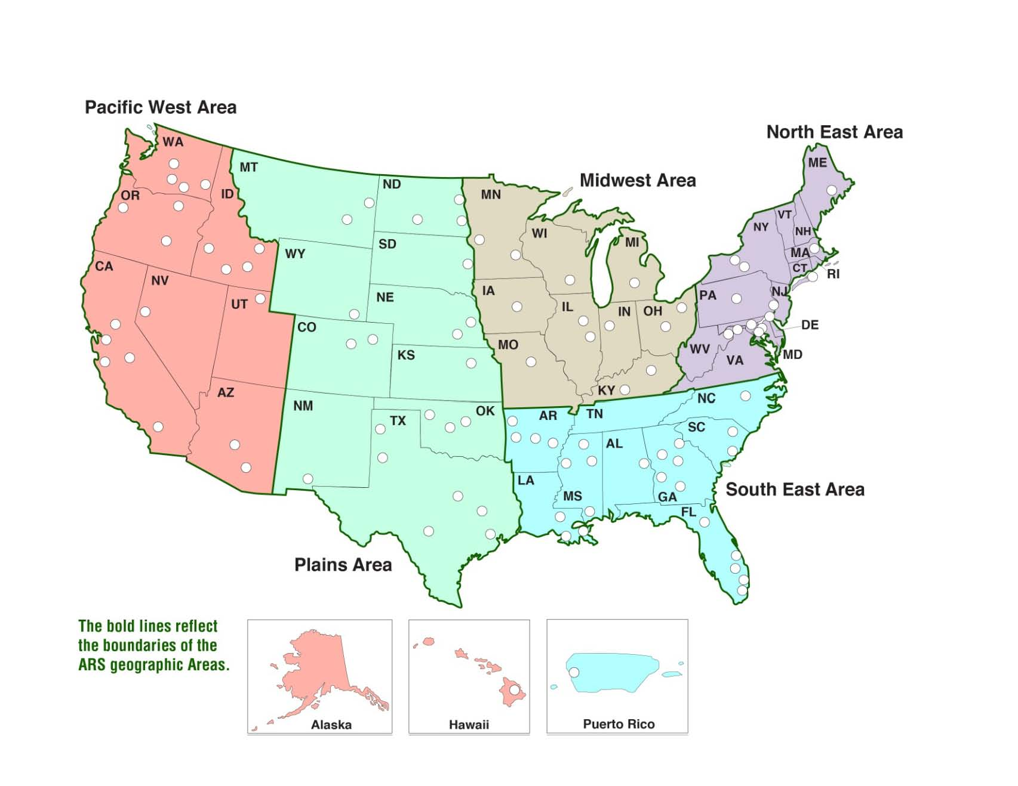
ARS Locations

Slide 5
4
Input
3
5 years of Research
5
Planning
of next 5-
years
2
1

Slide 6
Stakeholder Needs
National Needs
National Plan
Assignment of Objectives by National Program Leader
Researchers write 5-year plan for research
Outside Scientific Review
5- year Research Program begun
Research does not go forward

Slide 7

Creation of OSQR
“1998 Farm Bill”
(A bill about Agriculture research but not a Farm Bill)
ARS research peer-
reviewed every 5 years
Most review panelists external to ARS
Satisfactory review
before beginning
research
Notes:
The National Agricultural Research, Extension, Education, and Economics Advisory Board (NAREEEAB) provides advice to the Secretary of Agriculture and land-grant colleges and universities on top priorities and policies for food and agricultural research, education, extension and economics. The Board is made up of 31 members, each of which represents a specific category of U.S. agricultural stakeholders, as mandated by Congress.

Slide 8
What Makes OSQR Reviews Unique?
Directed Research, Subject (objectives) assigned
Problems determined through internal planning processes
Researchers must propose research that addressed identified issues/problems
Not a funding decision
Funds already allocated for research, but not released…
Seeks to Improve Quality, not a funding decision
Panels are asked how to improve the research
Researchers MUST provide an appropriate response
Long-term so higher risk is possible
5-year horizon with contingencies

Slide 9
Like Review of a Manuscript
Document should present a logical, coherent
narrative with a clear path for the research.
- “Editor” = SQRO
- Three outcomes
1. Publish as presented (no revision)
2. Publish after revision as monitored
by the “editor” (SQRO). Reviewers clear on what
researchers are planning (minor gaps in info).
(minor, moderate revision)
3. Publish after revision and reexamination by both reviewers and SQRO. Reviewers not at all
clear about what researchers are planning (major
gaps in info). (major revision, not feasible)
Agency tracks initial and final review. Result of initial review considered in annual performance evaluation.

Slide 10
National Programs
Crop Production and Protection
Nutrition, Food Safety, and Quality
Animal Production and Protection
Natural Res. & Sust. Agric. Systems
301. Plant Genetic Resources, Genomics & Genetic Improvement
303. Plant Diseases
304. Crop Protect.& Quarantine
305. Crop Production
107. Human Nutrition
108. Food Safety (animal & plant products)
306. Quality & Utilization of Agricultural Products
101. Food Animal Production
103. Animal Health
104. Veterinary, Medical, and Urban Entomology
106. Aquaculture
211. Water Avail & Watershed Mgmt
212. Climate Change, Soils and Emissions*
213. Biorefining
215. Rangeland, Pasture & Forages
Agricultural Competitiveness & Sustainability
Notes:
Currently, the National Program Staff has organized ARS research into 22 National Programs Our 22 National Programs are aligned under the three broad categories of: Animal Production, Product Value and Safety; Natural resources and Sustainable Agricultural systems; and Crop Production, Product Value and Safety.

Slide 11
Project Plans not Proposals
Not Proposals for research
Subject/objectives established by process
Funding decisions made by plan or mandate
Panels do not evaluate budgets
Plan for Research
Panel assesses if plan adequate to address problem
Assessment of Impact
Will research produce new information or understanding?

Slide 12
Document Overview
Entire document sent as PDF by email
Title and Investigators..………….page 1
Signature Page……………...........page 2
Table of Contents……….………….page 3
Project summary (250 words)...page 4
Objectives...…………..................page 5
Need for research (1-2 p)
Scientific Background (5-7 p)
Prior Accomplishments (2 p)
Approach & Procedures (6-15 p)
Milestone Table (1-3 p)
Literature Cited
Past Accomplishments of Project Team
Issues of Concern statements
Appendices (letters plus other material)
This section is page-limited
See Peer Review Guidelines in Folder for page limits.

Slide 13
Panel Functions
Panel is NOT reviewing
National Program direction, objectives or funding
Chair
Selects the reviewers and also serves as a panel member
Panelists
Serve as primary and secondary reviewers as designated by chair and provide comments in discussion of all plans.
Advisory Component
Consensus advice of panel
Assessment Component
By law each panelist (including chair) rates each plan

Slide 14
Conflicts of Interest
Collaboration with project scientist within last FOUR years.
Coauthorship
Research collaboration
Thesis, dissertation, postdoc advisor or graduate student/postdoc association within last EIGHT years.
Institutional or Consulting affiliation.
Submitting Institution, investigators, or collaborators
Financial gain from project.

Slide 15
Panel Diversity
Panels should be diverse representing:
The varying disciplines within the research area
Qualified men and women
The ethnic and cultural diversity of science
New and active as well as “seasoned” and active individuals
While we do not set quotas for diversity within panels because of their size, our goal is for the breadth of all reviewers across a national program review to be as diverse as possible.

Slide 16
Chair Responsibilities
Chair proposes a brief list of potential reviewers
OSQR reviews those for conflicts and may suggest others as well.
Chair contacts potential reviewers to secure agreement to serve (one for each plan).
Chair sends reviewer names and their primary and secondary assignments to OSQR
OSQR Reviews proposed panel with Officer for final approval.
OSQR “sets up” reviewers, informing them of their assignments, setting a date for review, sending plans, and briefing them on the process.
Chair moderates review discussions.
Chair provides brief letter to close the process.

Slide 17
Review Process (online)
4-5 days before online meeting
1-2 days before online meeting
Reviewers return completed
written comments
OSQR formulates draft
consensus (minimal edits)
Draft consensus
sent to review panel
Online meeting
Panel discusses and edits draft consensus using web conferencing tools
Primary Reviewer
Comment (up to 5 min)
Secondary Reviewer
Comment (up to 5 min)
Other comment
(up to 5 min)
Action Class scoring of plan
By panelists
General panel discussion
Edit consensus
(up to 15 min)
Conclusion of online meeting
Last opportunity to reconsider scores.
After close of meeting OSQR copy edit consensus and insert response boxes.

Slide 18
Ad Hoc Reviews (optional)
Provide Additional Expertise not on Panel
Identified by Chair in advance of Panel Meeting.
Invited by OSQR Staff
Ad Hoc Reviewers DO NOT attend panel meetings.
Action Class Rating of Ad Hoc Reviewers NOT included in final panel score.

Slide 19
Review Criteria
Adequacy of Approach
Are the research plan and procedures appropriate? Is there sufficient information to understand the procedure proposed? Does the plan display understanding of the technologies and methodologies proposed? Are the roles of researchers and collaborators clearly presented. Does the overall plan present a clear, logical, experimental design? Is the plan well-written and clear?
Probability of Success
Is the plan likely to lead to success or, if successful will it produce significant new knowledge (If there is a significant risk of failure, are the risks justified by the potential payoffs?)?
Merit and Significance
Will this lead to new information, new findings, or new understandings? What would be the impact of this work on stakeholders? Society? Agriculture?

Slide 20
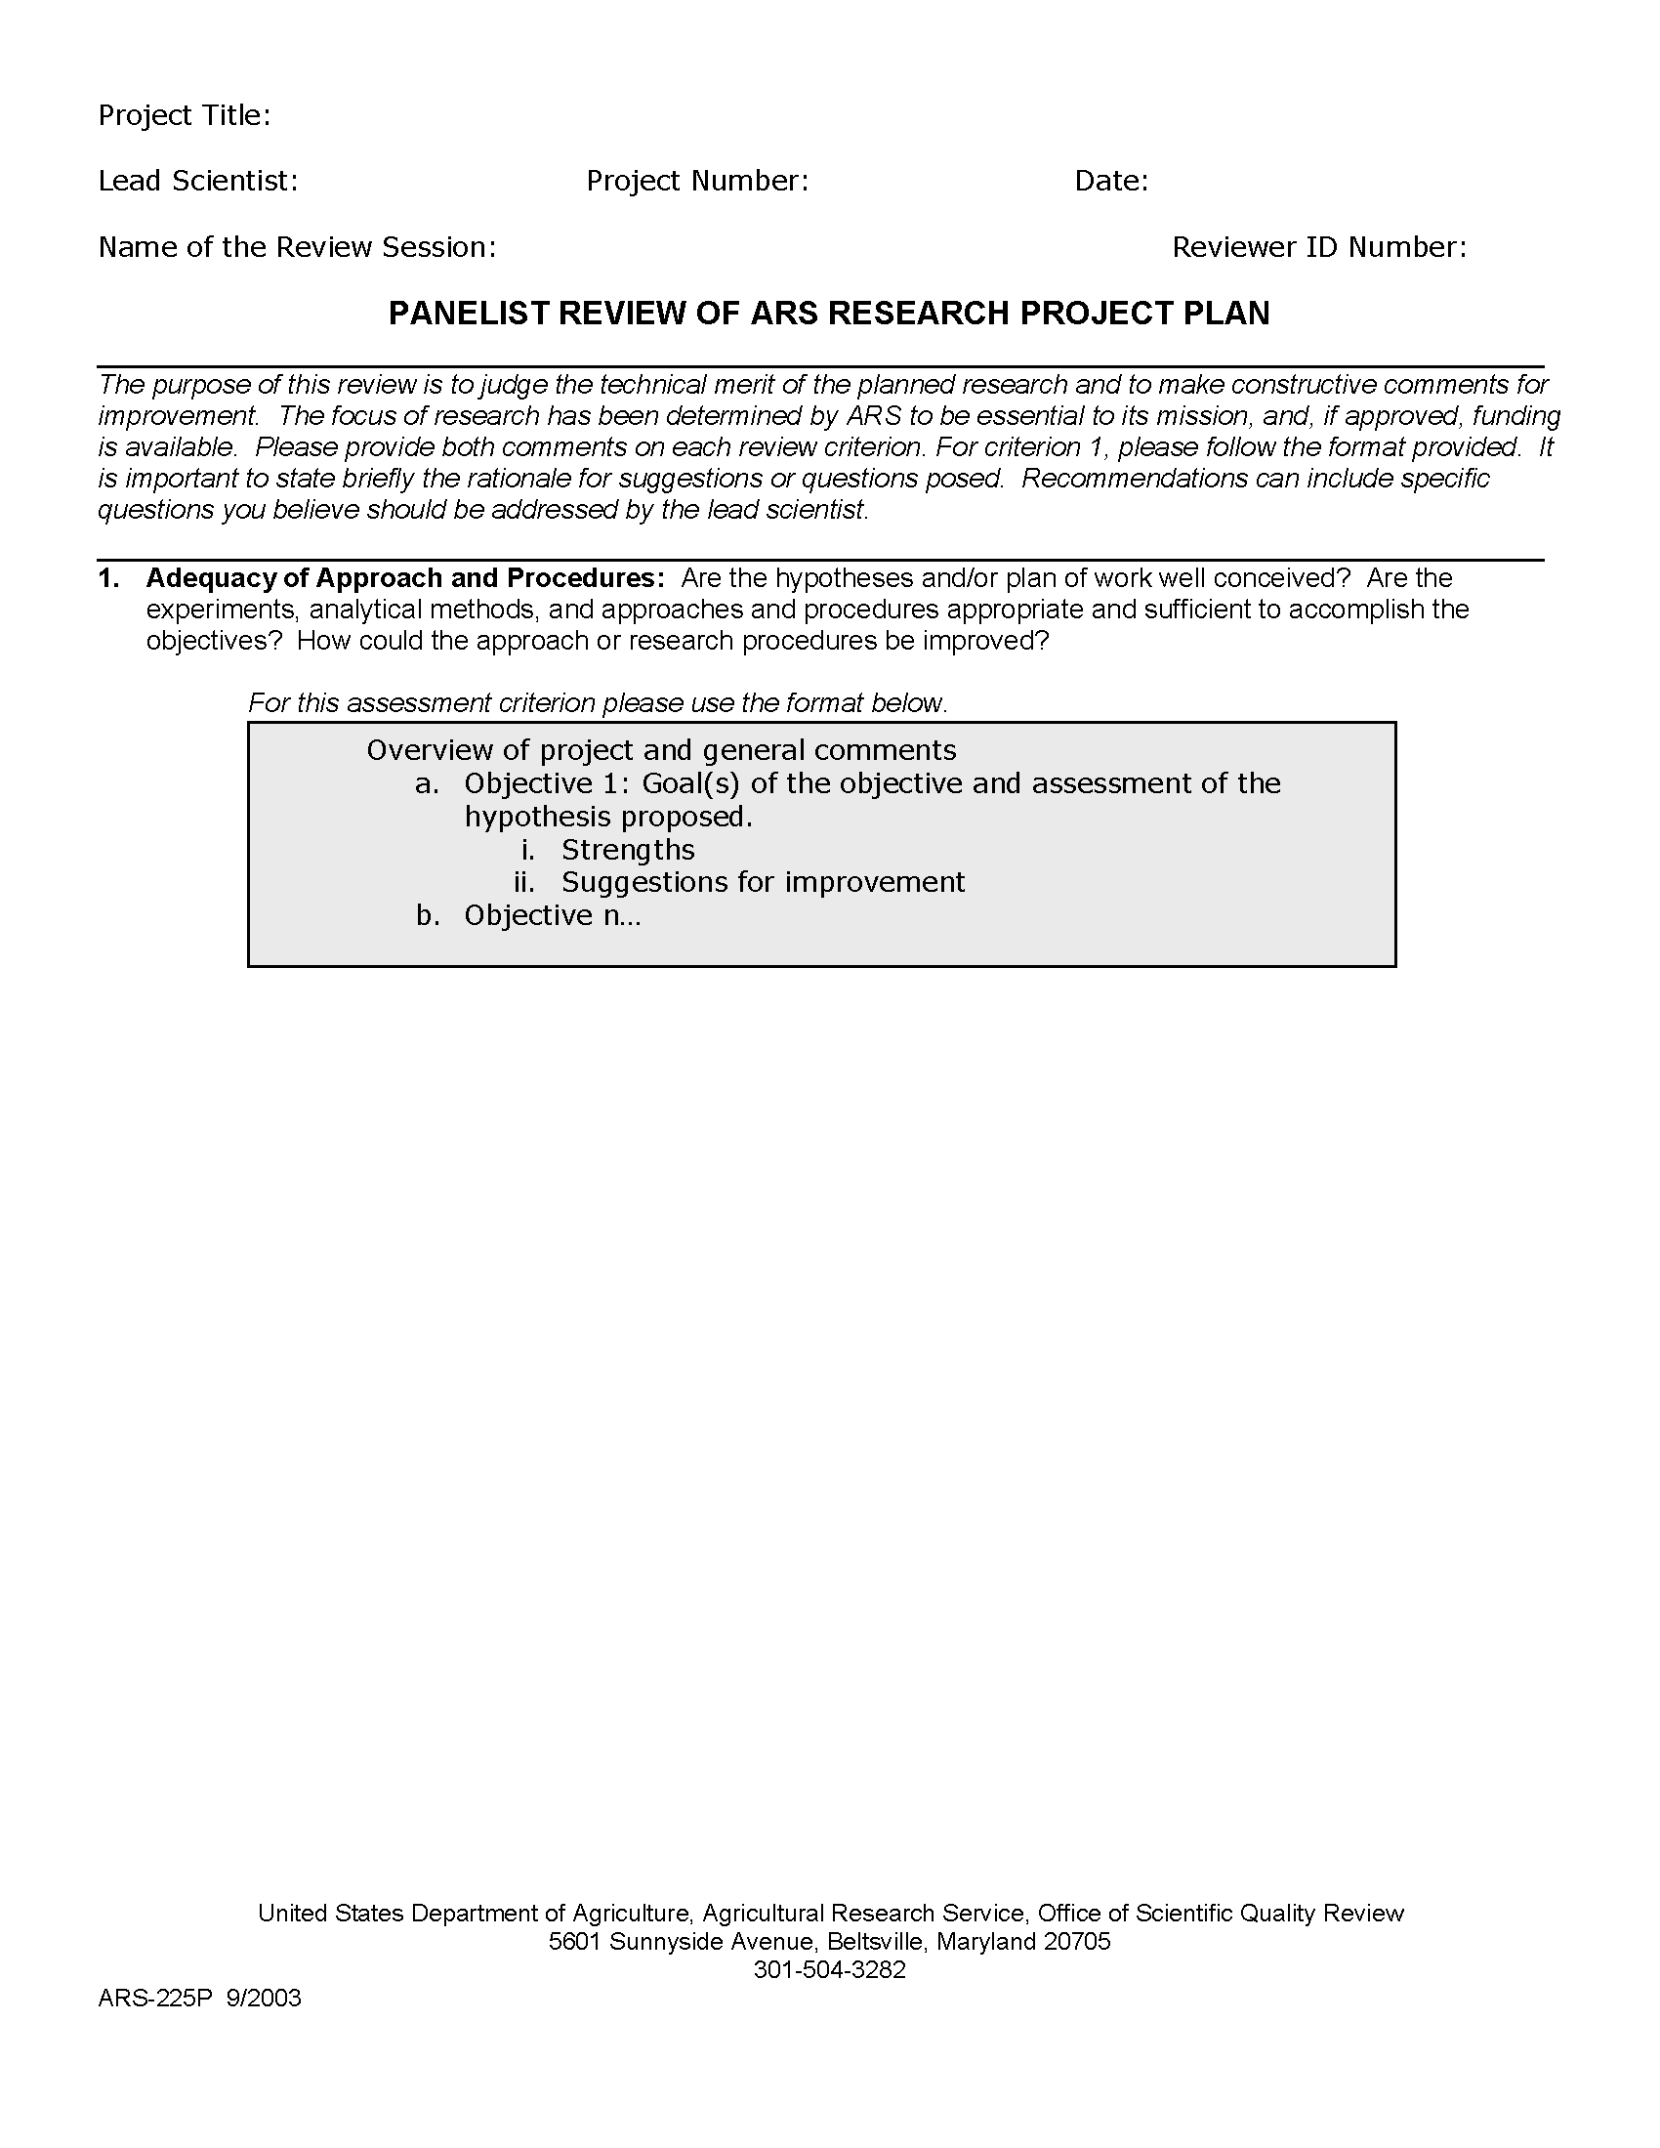
Panelist Review Form
Primary and Secondary Reviewers complete this

Slide 21
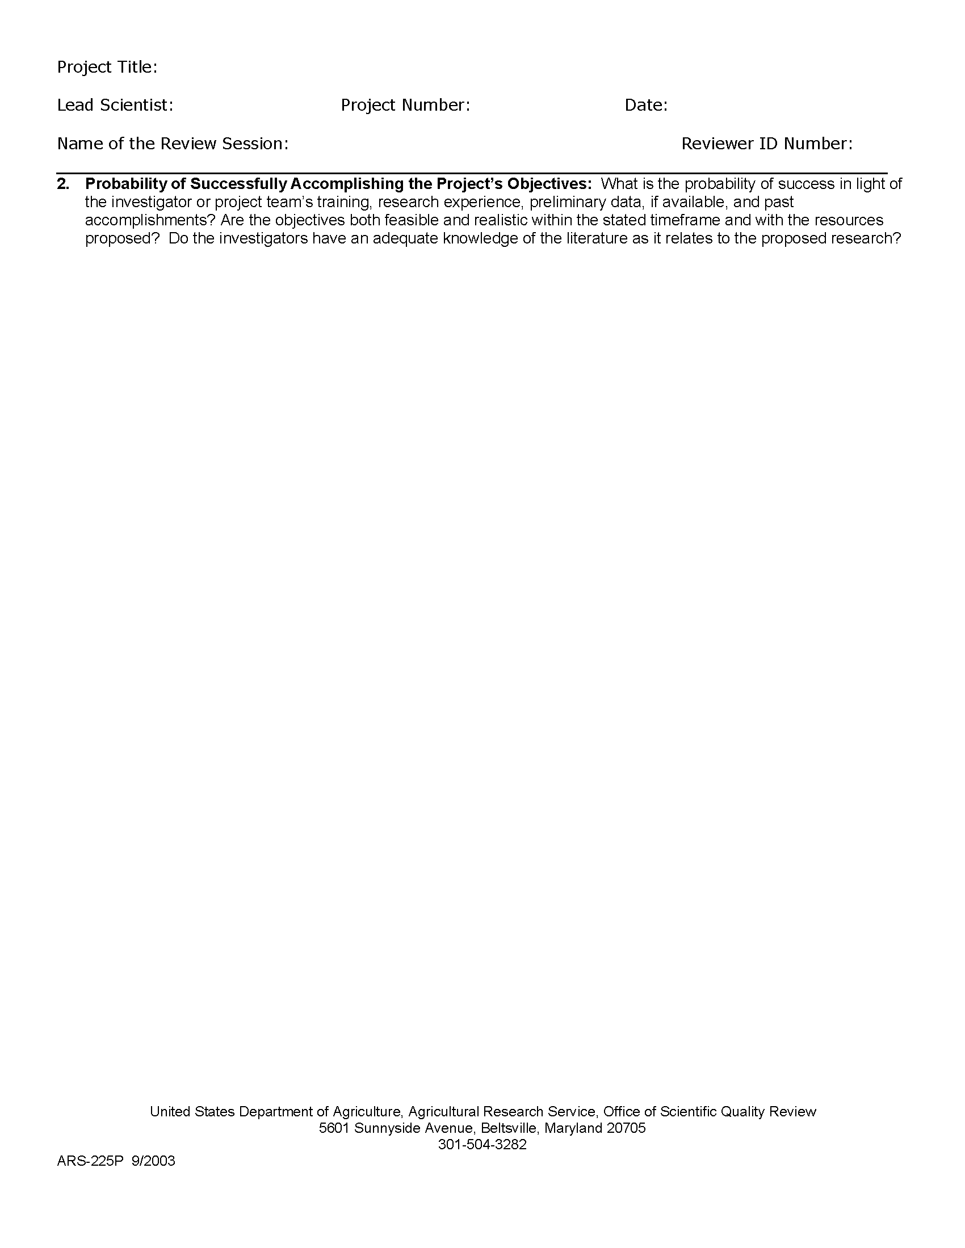

Panelist Review Form

Slide 22
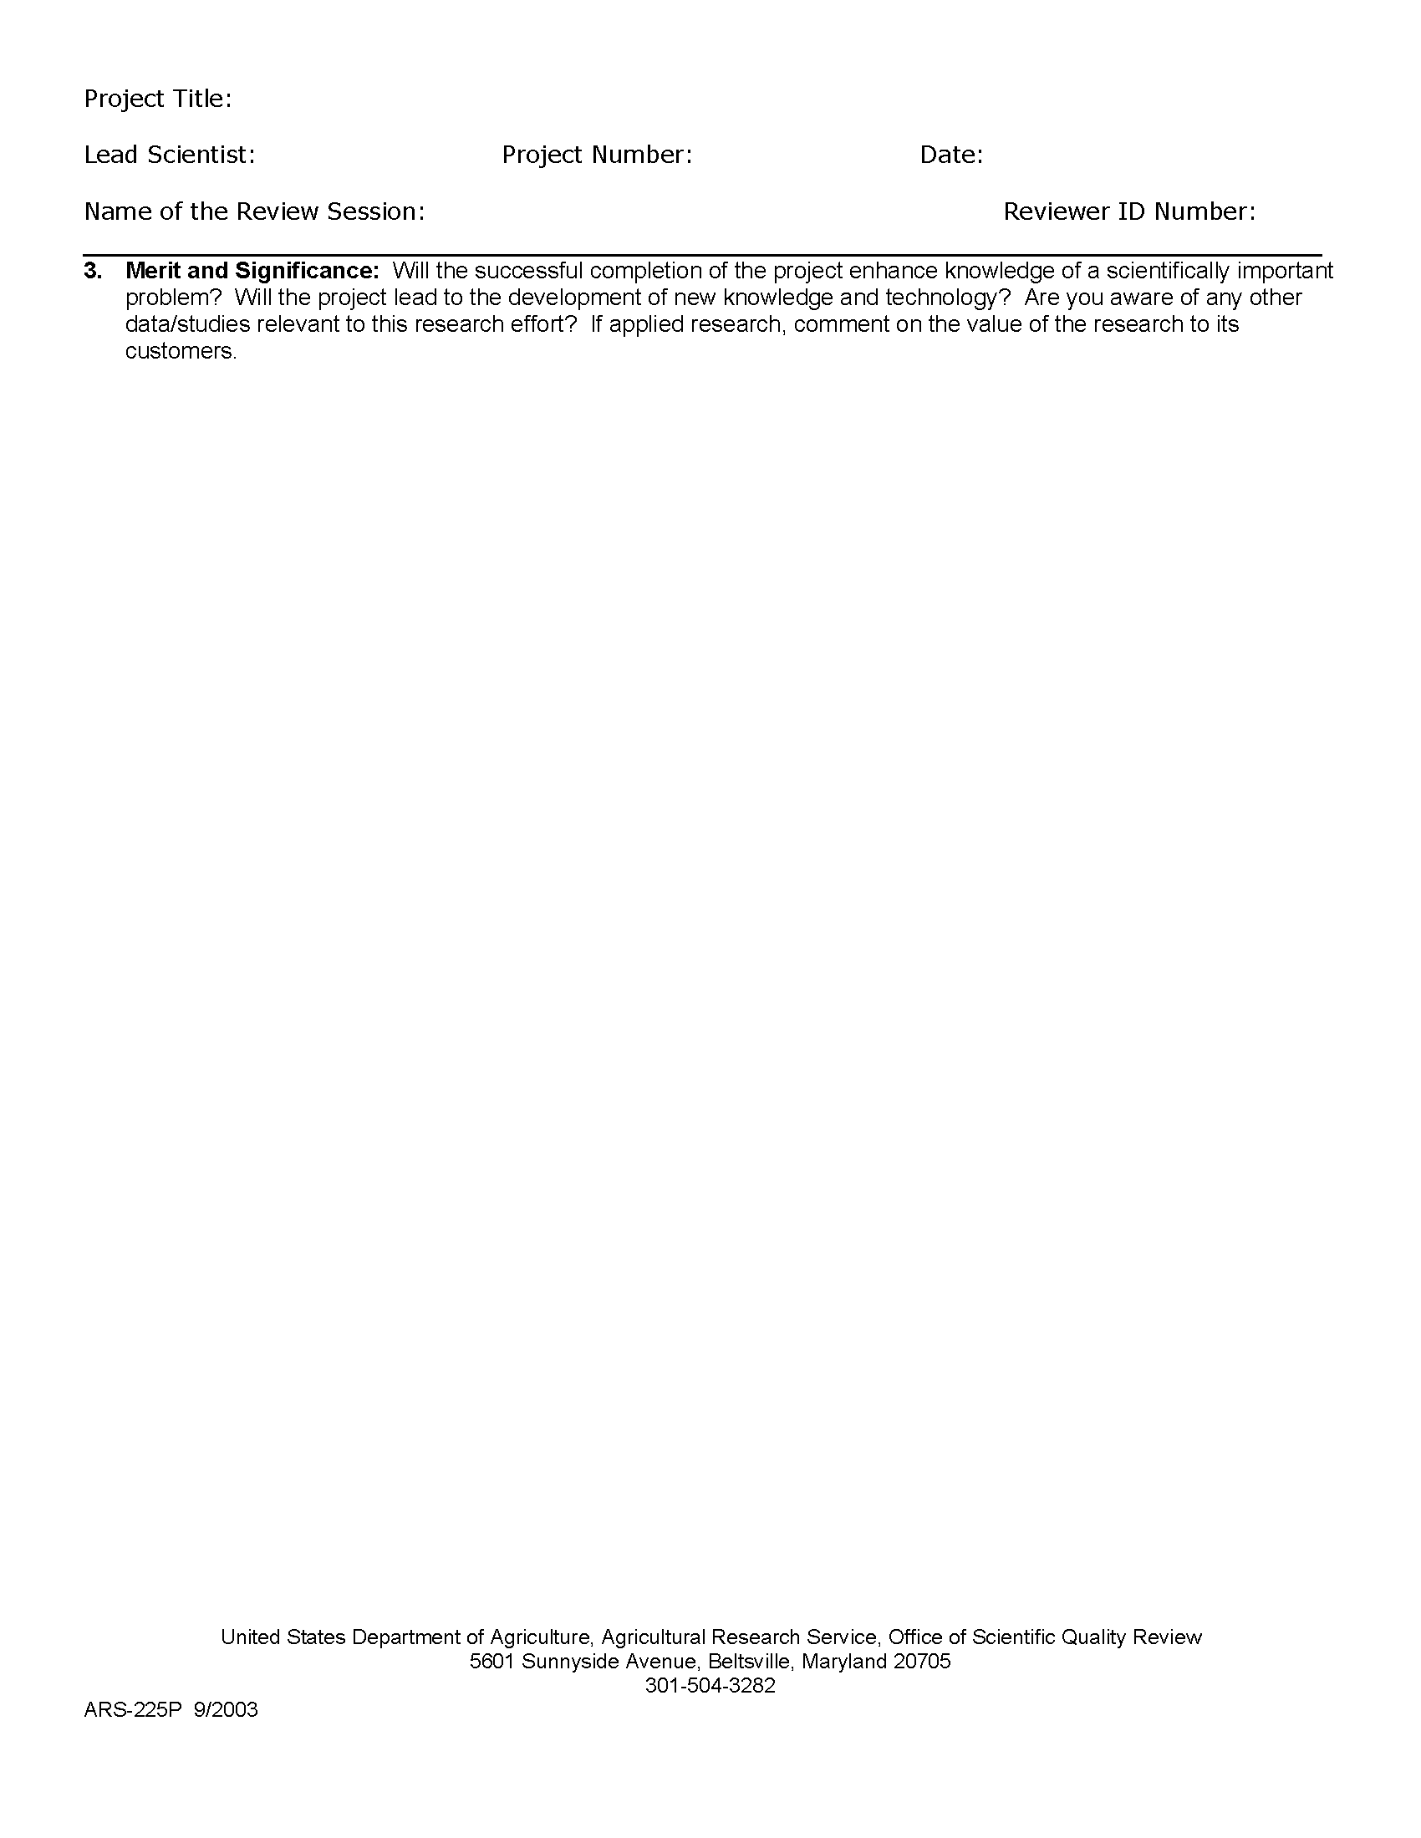

Panelist Review Form

Slide 23
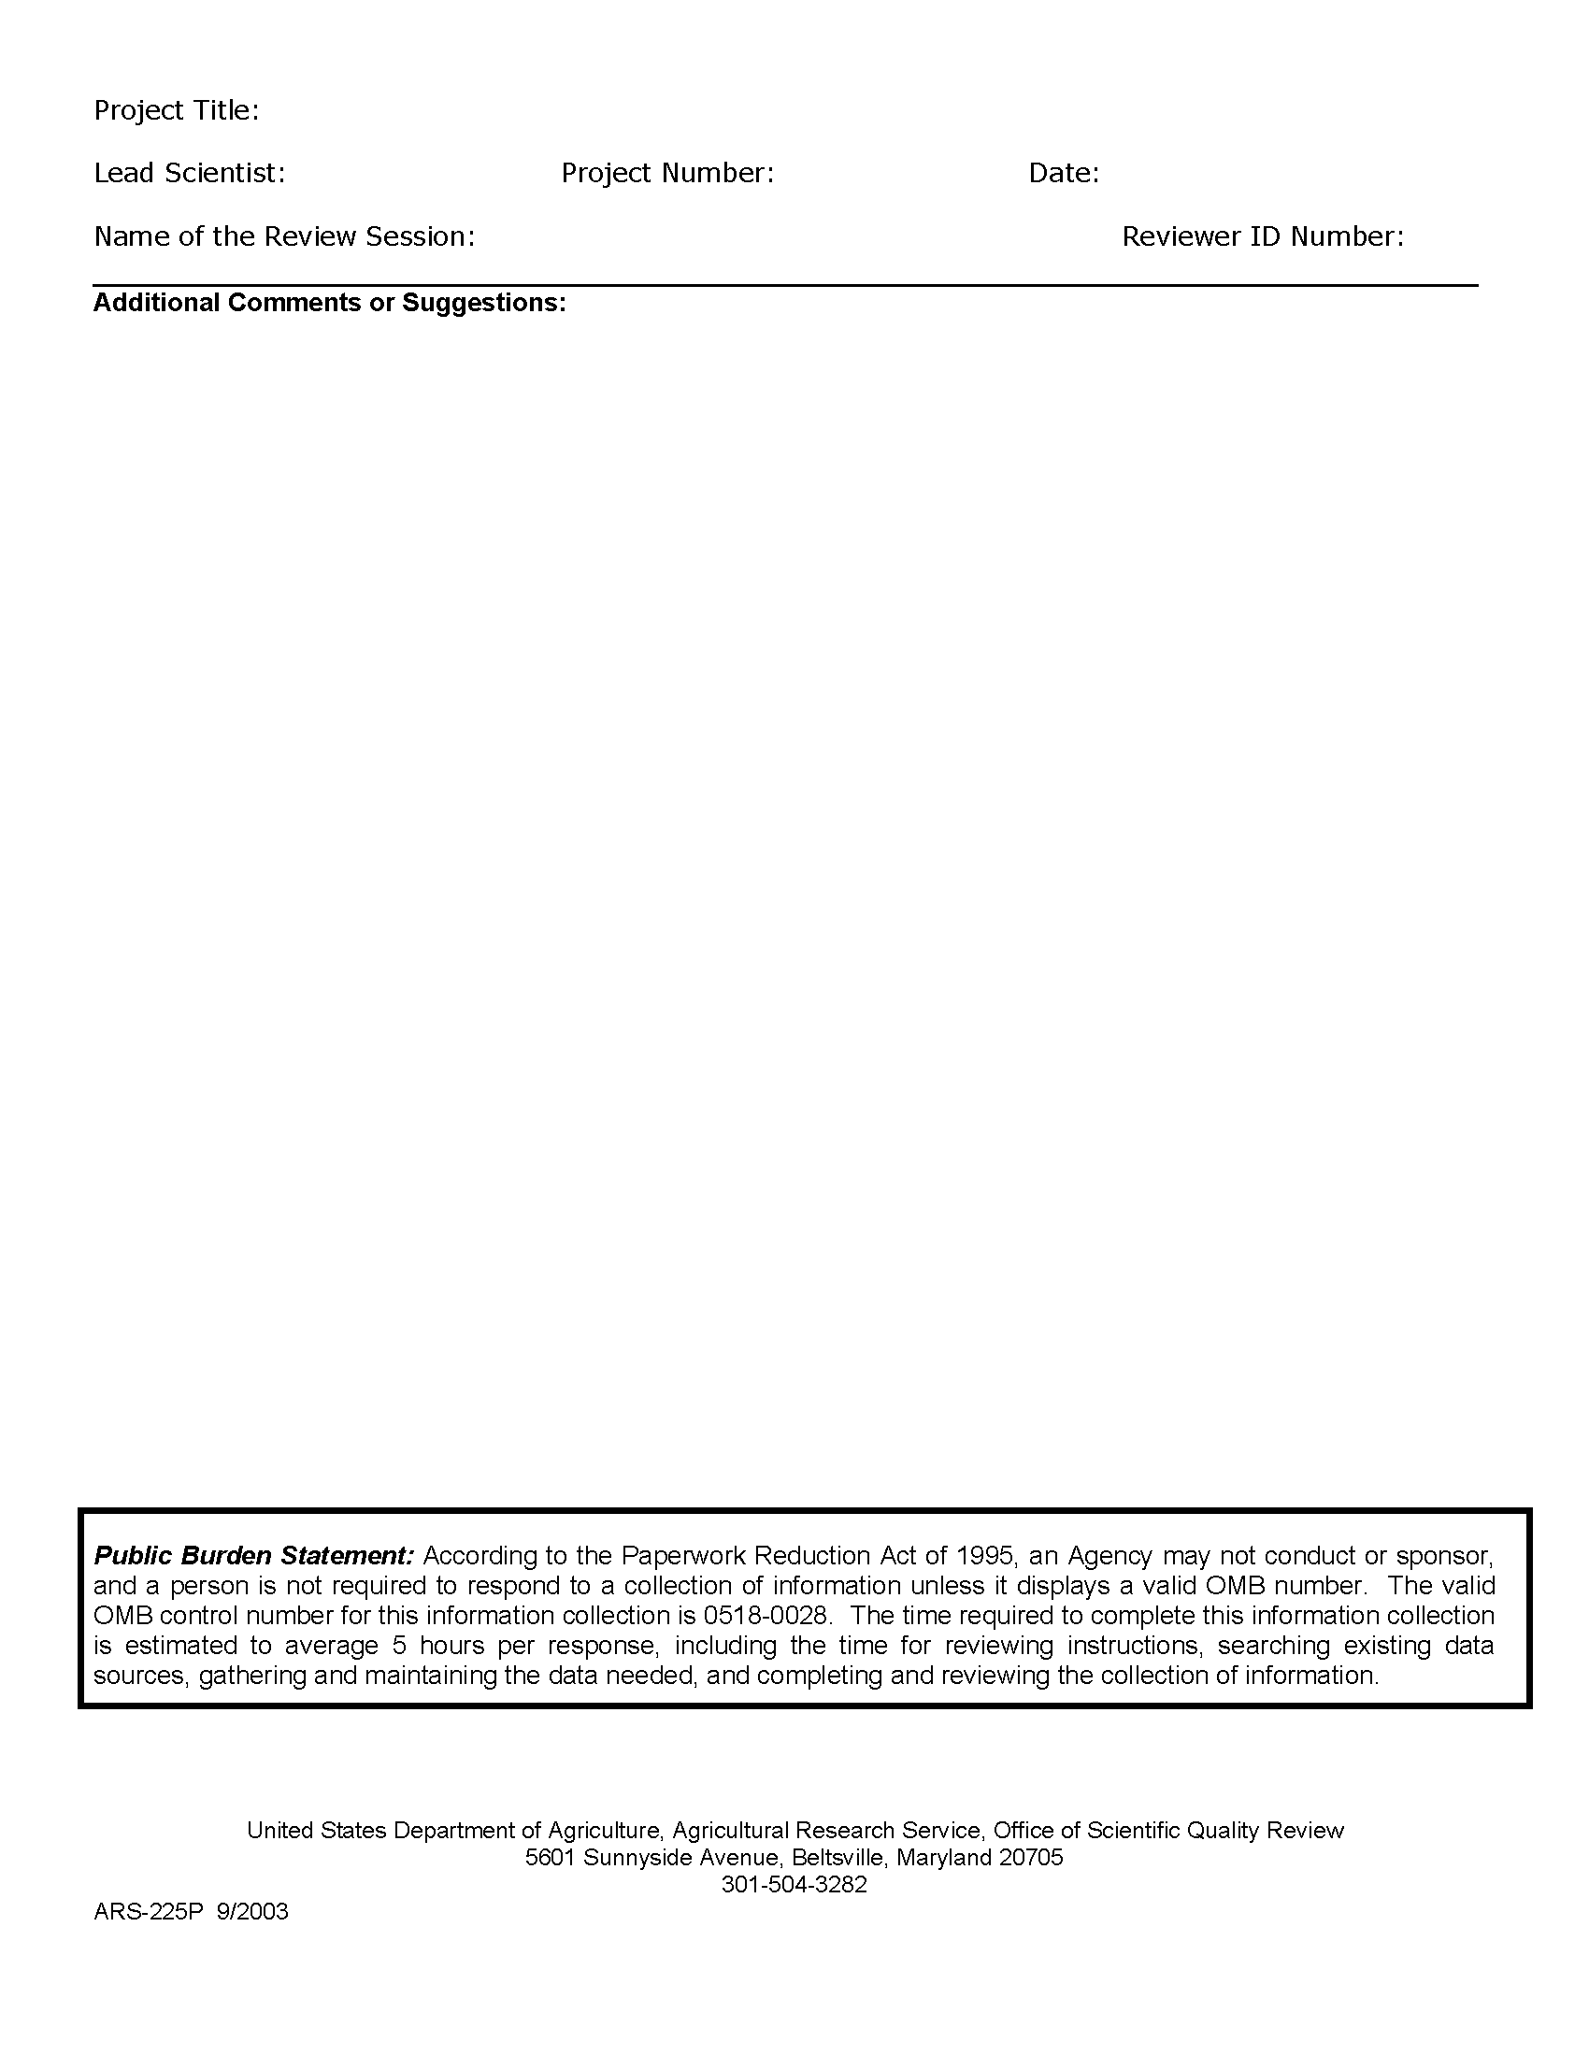

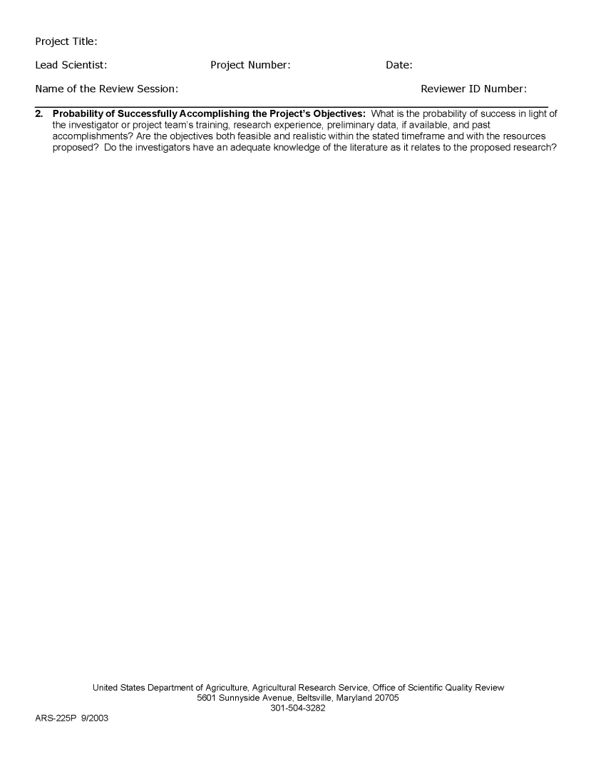

Panelist Review Form
Before the meeting OSQR will cut & pasted to produce a draft consensus

Slide 24
Action Class Ratings
No Revision
Excellent project. No changes or additions are required
(although suggestions may be made)
Minor Revision
Approach sound. Project feasible.
Some minor changes are required
Moderate Revision
Some change to an approach needed
but project is feasible.
Major Revision
Sound and feasible IF significantly revised. Major gaps in plan or information provided. Revised plan must be reviewed again before acceptance.
Not Feasible
Major flaws, omissions, or deficiencies in resources make this unfeasible or not possible to assess. Project revised and reviewed again or terminated.

Slide 25
What Happens After Review? (Researcher)
No, Minor or Moderate Revision
-Lead Scientist responds to comments.
-Officer certifies compliance with recommendations
…much like a journal editor.
Plans are not certified until review comments are fully addressed.
Major Revision or Not Feasible
-Lead Scientist revises and responds to comments.
-Examined by panel at Web-based meeting (Re-Review).
-Plan receives a new Action Class Score.
Plans receiving Major or Not Feasible
scores at Re-Review
are deemed to have failed review.

Slide 26
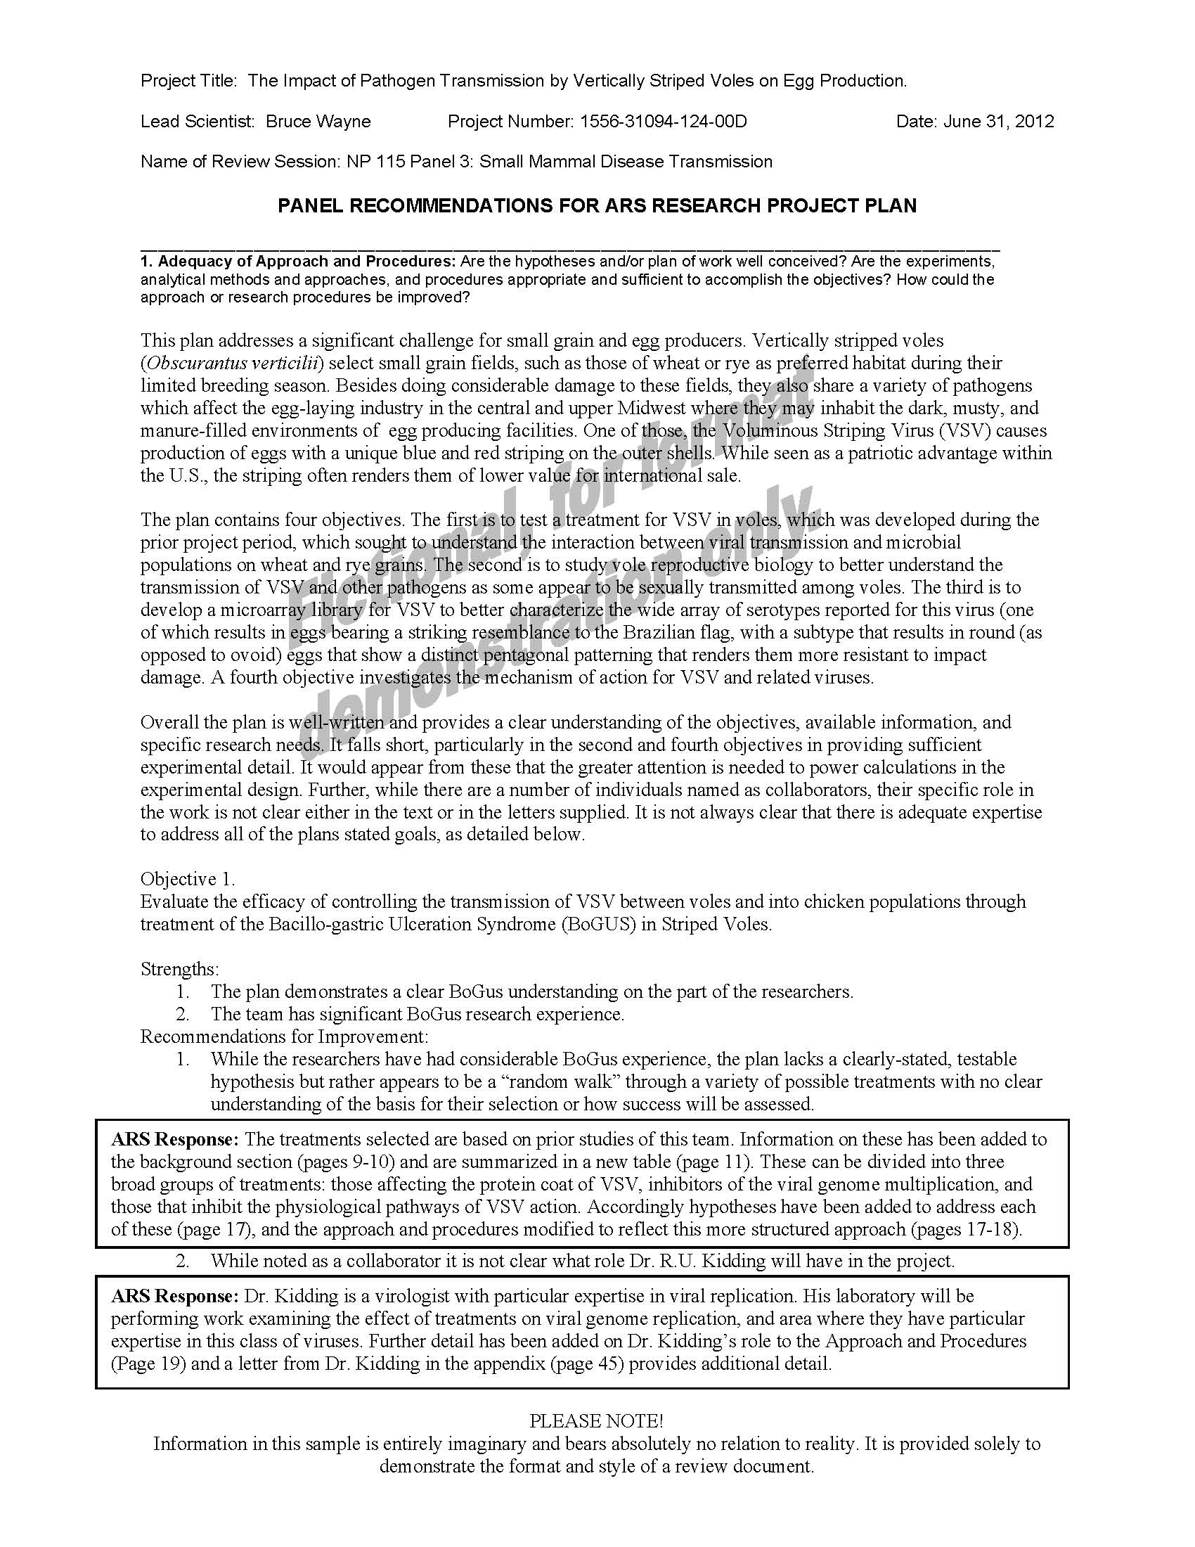

Slide 27
After Review (Chair)
Chair’s written summary of discussions Reviewers are not named, general issues, no specific plan discussion. Template provided.

Slide 28
Honorarium
-Typically paid by bank transfer.
-Federal employees can serve but do not receive an honorarium.
- Paid in full or partial at end of initial review meeting.
- If needed, balance at conclusion of re-review meeting

Slide 29
What Next?
Panel Appointment:
Using our list and your personal knowledge select a list of potential panelists (one for each plan).
Send your list to Mike at mike.strauss@ars.usda.gov to check for conflicts.
Once Panel is appointed…
OSQR will work with all to set dates for your meeting. Send plans and review materials to reviewers, and provide an online briefing of their responsibilities.
We will brief your panel on the process and their obligations once they are appointed.

Slide 30
Peer Review Resources
OSQR Web Site
www.ars.usda.gov/osqr
Office of National Programs
OSQR Staff
Scott.Yates@ars.usda.gov
Mike.strauss@ars.usda.gov
Michele.Shaw@ars.usda.gov
Linda.dalylucas@ars.usda.gov
osqr@ars.usda.gov

Slide 31
Input

